Slide 2
Chapter One Hope in the Darkness: The Beginning of Life as we know it (Creation)

Slide 3
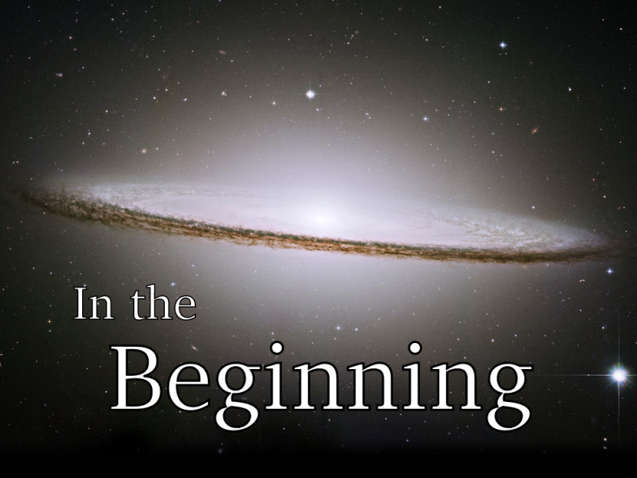
God’s Story Starts with a BIG BANG!
Genesis 1:1 In the Beginning GOD created the heavens and the earth.

Slide 5
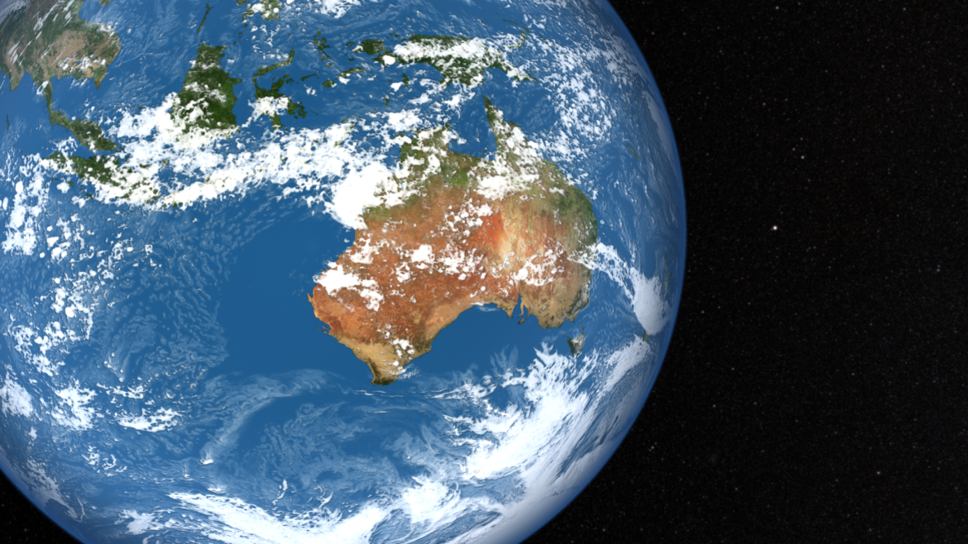
God’s Story Starts with a BIG BANG!
Genesis 1:1 In the Beginning GOD created the heavens and the earth.

Slide 6
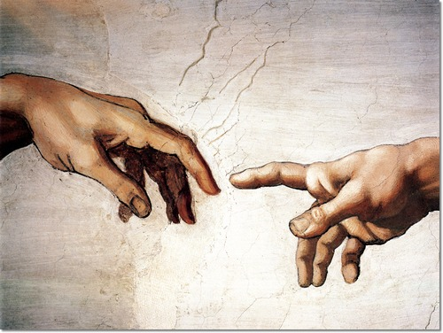
God’s Story Starts with a BIG BANG!
“The “big bang” of Creation is not an impersonal accident, but the creative purpose of a personal God.” Frazee

Slide 7
Genesis 1:26Then God said, “Let us make mankind in our image, in our likeness, so that they may rule over the fish in the sea and the birds in the sky, over the livestock and all the wild animals,[a] and over all the creatures that move along the ground.”
27 So God created mankind in his own image,
in the image of God he created them;
male and female he created them.

Slide 8
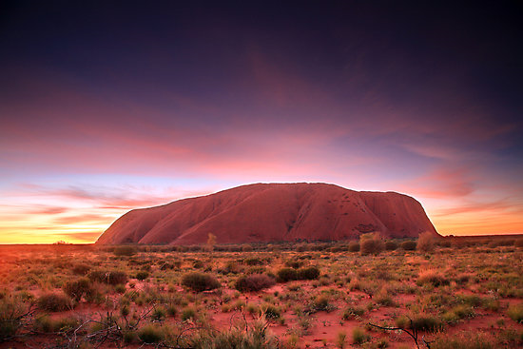
Genesis 1:31 God saw all that he had made, and it was very good. And there was evening, and there was morning—the sixth day.

Slide 9
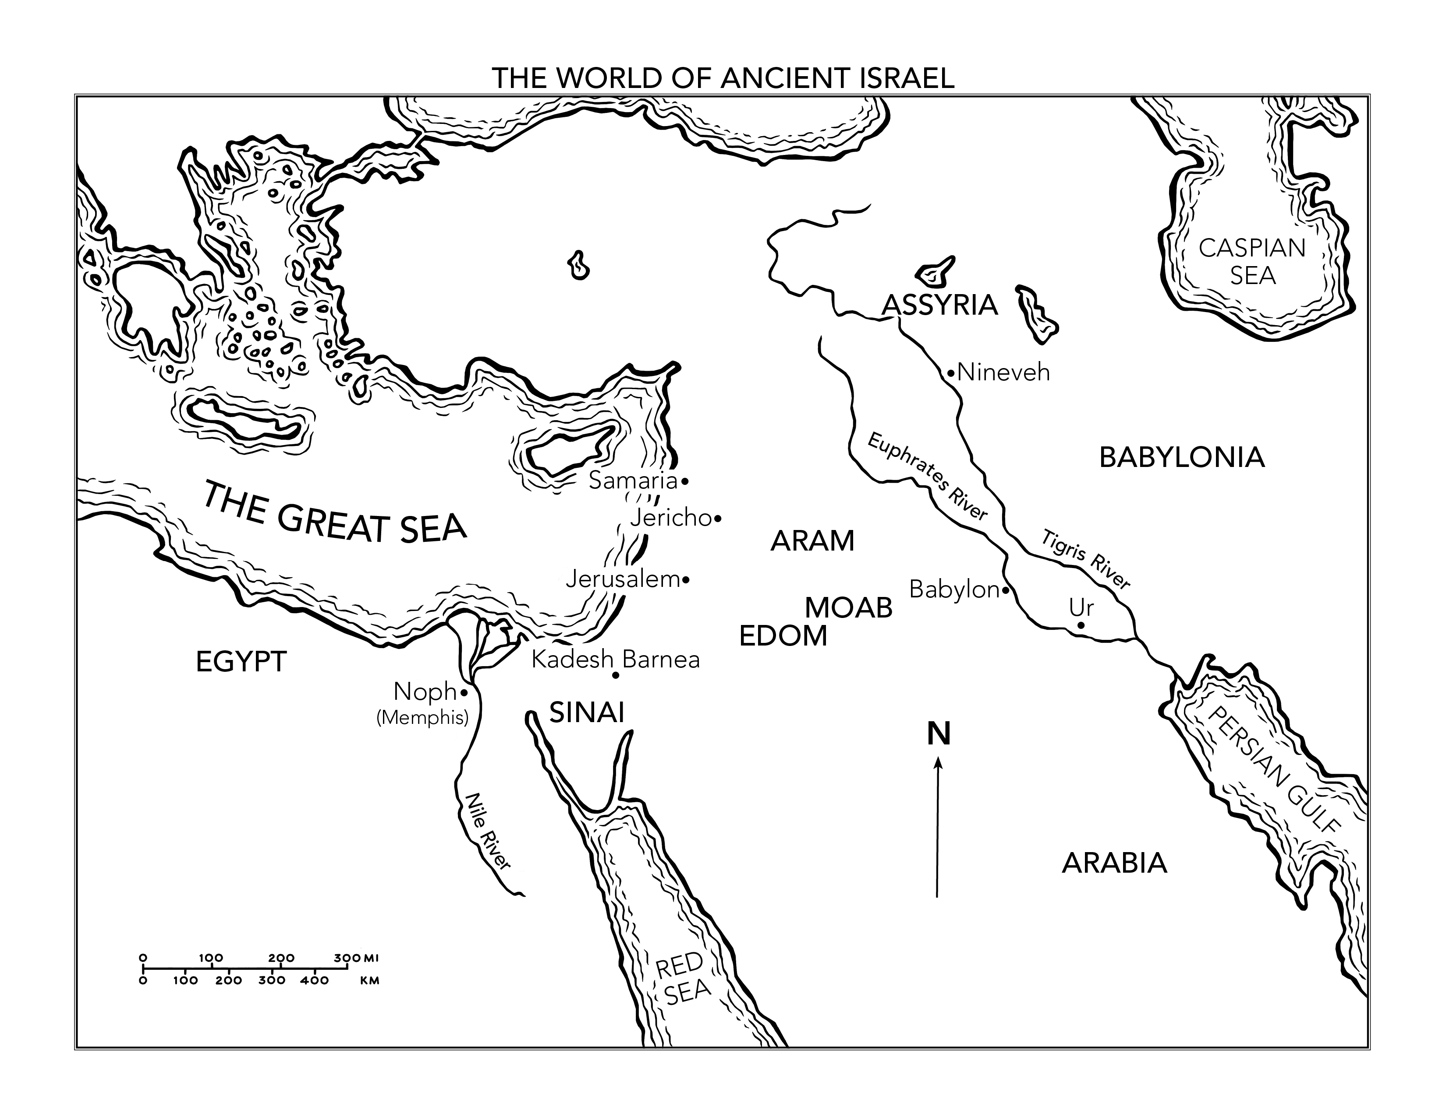

Slide 10
Genesis 2:15 The Lord God took the man and put him in the Garden of Eden to work it and take care of it. 16 And the Lord God commanded the man, “You are free to eat from any tree in the garden; 17 but you must not eat from the tree of the knowledge of good and evil, for when you eat from it you will certainly die.”
Genesis 2: 9b In the middle of the garden were the tree of life and the tree of the knowledge of good and evil.

Slide 11
Genesis 3:8 Then the man and his wife heard the sound of the Lord God as he was walking in the garden in the cool of the day, and they hid from the Lord God among the trees of the garden. 9 But the Lord God called to the man, “Where are you?”
10 He answered, “I heard you in the garden, and I was afraid because I was naked; so I hid.”
11 And he said, “Who told you that you were naked? Have you eaten from the tree that I commanded you not to eat from?”
12 The man said, “The woman you put here with me—she gave me some fruit from the tree, and I ate it.”
13 Then the Lord God said to the woman, “What is this you have done?”
The woman said, “The serpent deceived me, and I ate.”

Slide 12
Genesis 3:23 So the Lord God banished him from the Garden of Eden to work the ground from which he had been taken. 24 After he drove the man out, he placed on the east side[e] of the Garden of Eden cherubim and a flaming sword flashing back and forth to guard the way to the tree of life

Slide 13
The Point of the Whole Story!
This is God’s Vision for you, for us; God wants to be with us, God wants to be with you and the rest of The Story is about God’s pursuit to get us back. As you read you will discover that he will do anything to fulfil His mission, He’ll do anything to get us back.

Slide 14
Genesis 6:5 The Lord saw how great the wickedness of the human race had become on the earth, and that every inclination of the thoughts of the human heart was only evil all the time. 6 The Lord regretted that he had made human beings on the earth, and his heart was deeply troubled. 7 So the Lord said, “I will wipe from the face of the earth the human race I have created—and with them the animals, the birds and the creatures that move along the ground—for I regret that I have made them.” 8 But Noah found favor in the eyes of the Lord.

Slide 16
Genesis 8:15 Then God said to Noah, 16 “Come out of the ark, you and your wife and your sons and their wives. 17 Bring out every kind of living creature that is with you—the birds, the animals, and all the creatures that move along the ground—so they can multiply on the earth and be fruitful and increase in number on it.”
18 So Noah came out, together with his sons and his wife and his sons’ wives. 19 All the animals and all the creatures that move along the ground and all the birds—everything that moves on land—came out of the ark, one kind after another.
20 Then Noah built an altar to the Lord and, taking some of all the clean animals and clean birds, he sacrificed burnt offerings on it. 21 The Lord smelled the pleasing aroma and said in his heart:
“Never again will I curse the ground because of humans, even though[a] every inclination of the human heart is evil from childhood. And never again will I destroy all living creatures,
as I have done.

Slide 17
Genesis 9:12 And God said, “This is the sign of the covenant I am making between me and you and every living creature with you, a covenant for all generations to come: 13 I have set my rainbow in the clouds, and it will be the sign of the covenant between me and the earth.
Genesis 9:20 Noah, a man of the soil, proceeded[a] to plant a vineyard. 21 When he drank some of its wine, he became drunk and lay uncovered inside his tent. 22 Ham, the father of Canaan, saw his father naked and told his two brothers outside. 23 But Shem and Japheth took a garment and laid it across their shoulders; then they walked in backward and covered their father’s naked body. Their faces were turned the other way so that they would not
see their father naked.

Slide 18
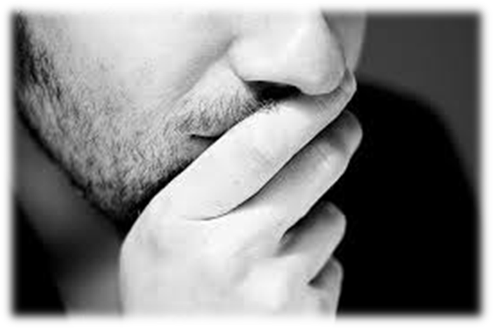
Space to Reflect

Slide 19
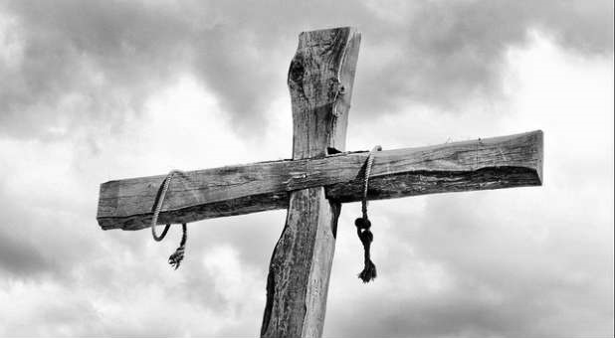
1 John 2:1 My dear children, I write this to you so that you will not sin. But if anybody does sin, we have an advocate with the Father—Jesus Christ, the Righteous One. 2 He is the atoning sacrifice for our sins, and not only for ours but also for the sins of the whole world.

